Slide 1
CloudVOTE Web App Tutorial
Presenter Tips

Slide 2
CloudVOTE Account
Log Into Your Account

Slide 3
CloudVOTE Account
As a Presenter/Operator, log into your CloudVOTE account here:
my.cloudvote.com
Other shortcuts:
mycloudvote.com (direct alternative to above URL)
cloudvote.com/account (Presenter/Operator login)
cloudvote.com/join (Participant/Attendee login)

Slide 4
Import Content
CloudVOTE Templates are blank, reusable ‘shells’ with mixed content. Create your training/presentation content in PowerPoint. You can include static content slides, as well as question slides.
After importing the PowerPoint (PPTX) file to CloudVOTE, it becomes a read-only Template. If you have a CloudVOTE “Master” account, the Template can be used by you, or anyone you assigned the Template to.

Slide 5
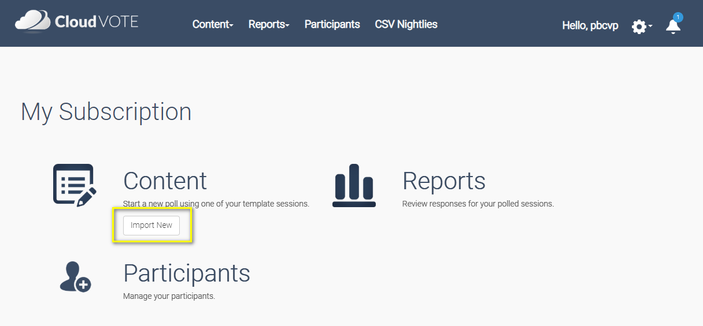
Import Content
Import your first presentation by clicking on the Import button on the CloudVOTE Dashboard.
Alternatively, go to the top Content page and use the Import button there.

Slide 6
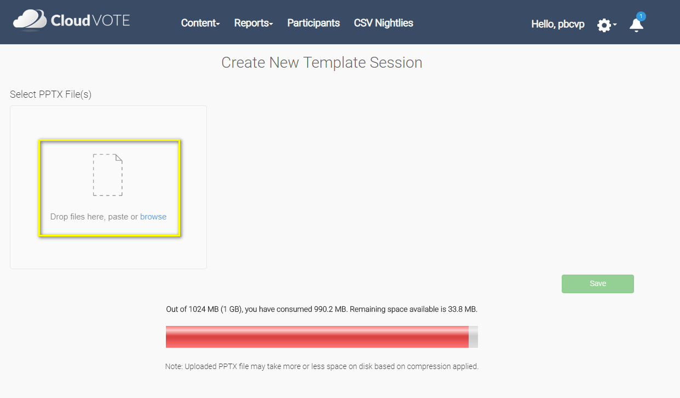
Import Content
On the next page, use the browse link to find the PPTX file you’re going to upload, or drag & drop the file to the ‘drop zone’.
You can upload multiple files at once.
If you can't drag & drop the PPTX file here, click the browse link instead
Beware of your available storage space and prepare for your next session by uploading everything well ahead of time.

Slide 7
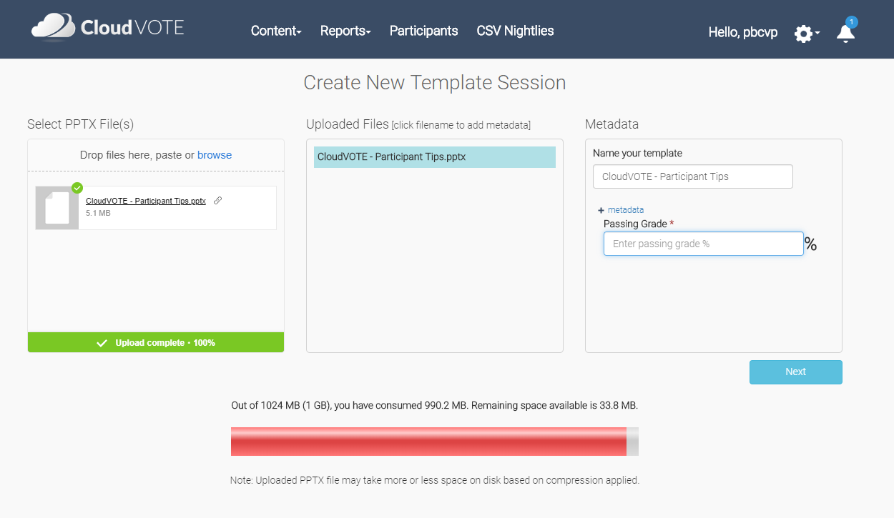
Import Content
In the next few steps, you will upload the PPTX file, (re)name your Template and specify any meta data that you need the Template to carry over into the exported reports (e.g. for import to your LMS).
Name your template, add/remove meta data with unique Template IDs or fields that you need the presenters/facilitators to fill out before starting the session.
Click Next/Save when you’re done.

Slide 8
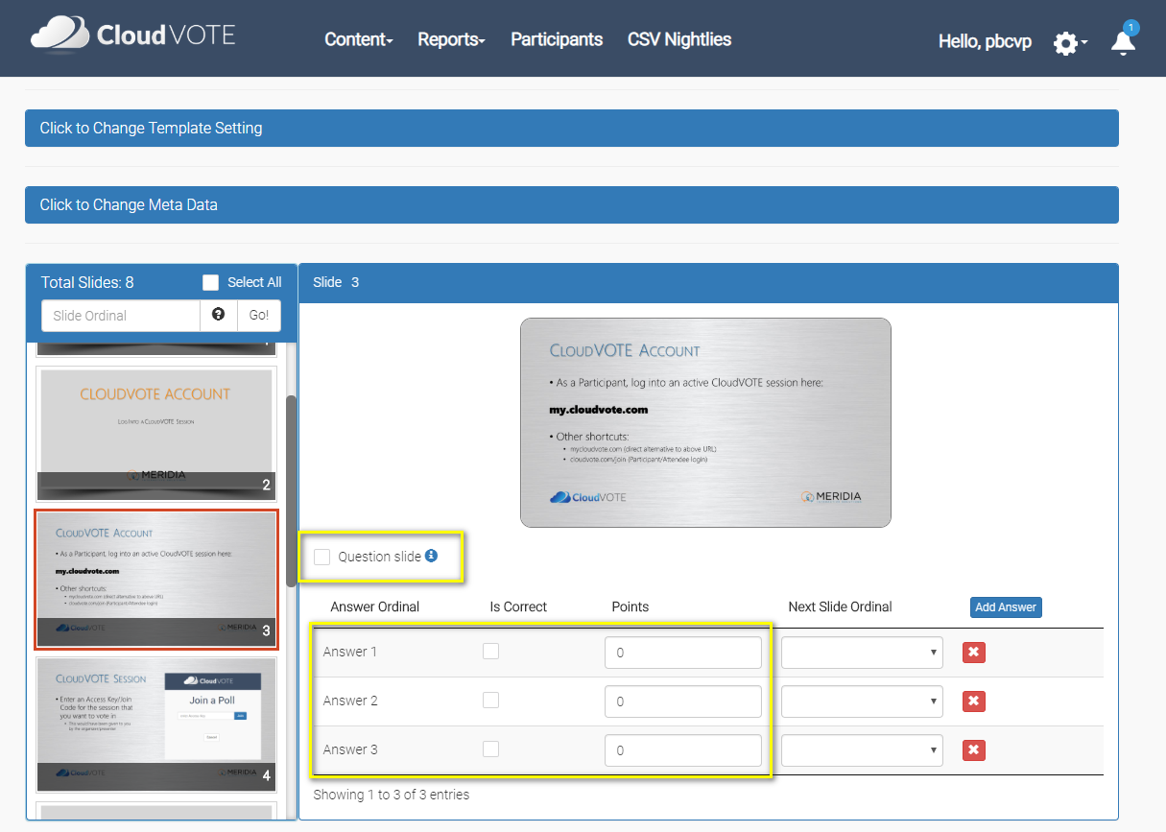
Import Content
Change your Template Setting, its name, meta data and review each slide so that you can automatically track question slides vs the static (non-interactive) ones.
In the final step, you will be asked to review your slides. It’s advisable that you do that, even though CloudVOTE can detect the Title & Content slide layout and make it into a question automatically.

Slide 9
Formatting TIPS
Formatting Your Question Slides in PowerPoint

Slide 10
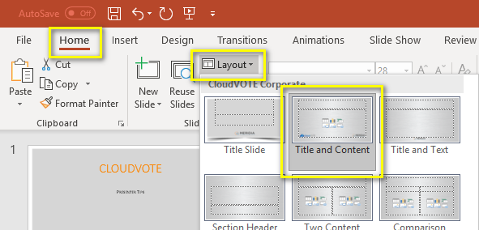
How to Format Question Slides
Use a “Title and Content” slide layout
When this layout is used, CloudVOTE will attempt to auto-detect the number of answer based on the number of bullets used on the slide
It will also attempt ‘read’ the question and answer text and use it in reports

Slide 11
How to Format Question Slides
Format your bullets/answers in either 1, 2, 3, or A, B, C style
If your answer choices are numbers, it’s best to use the A, B, C style

Slide 12
How to Format Question Slides
Be specific in how you state the question, so that the audience knows exactly how to vote
If it’s a multi-vote question such as “Select all that apply”, make sure you state that in the question text

Slide 13
How to Format Question Slides
When building a question slide for CloudVOTE, you may want to format the Question and Answer text boxes so that they are not covered by the voting results (chart) overlay.
On a standard, 16:9 (wide) slide, you should not have any text past the 2" mark to the right of the "0" mark in the middle.

Slide 14
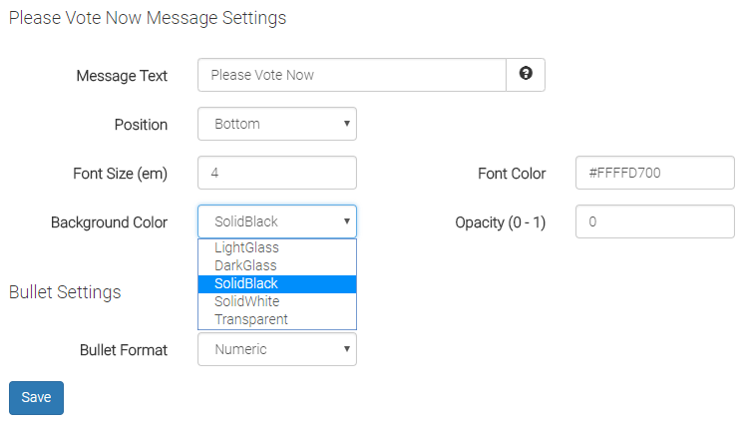
How to Format Question Slides
Don't want to be limited by the width of the text? No worries, you will see the entire content on the slide before being partially covered by the chart when you close polling.
As well, you can change the overlay 'sidebar' transparency to "light glass" or "transparent" and never worry about a dark overlay on top of your content again.

Slide 15
Formatting TIPS
Configuring Your Template and Slides in CloudVOTE (Web App)

Slide 16
Configure Single-Vote Slides in CloudVOTE
Mark slides as “Question” to automatically open polling by simply navigating forward
Add or remove answers if CloudVOTE didn’t auto-detect them correctly to match the number of voting buttons to the number of ‘bullets’

Slide 17
Configure Single-Vote Slides in CloudVOTE
Select a correct answer to track pass/fail rate
Assign points to report on the total scores (and winners) in the post-event reports
Users can change their answers if polling is open. Only the last vote counts.

Slide 18
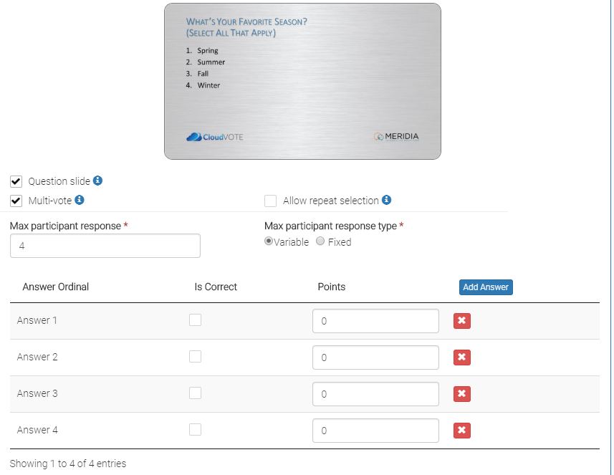
Configure Multi-Vote Slides in CloudVOTE
Check the ‘multi-vote’ option to allow multiple votes to be recorded from each attendee
Select the number of maximum votes allowed
Select ‘Variable’ response type if you want to use “Select all that apply” or “Select up to…X” question

Slide 19
Configure Multi-Vote Slides in CloudVOTE
Select ‘Fixed’ response type if you need each attendee to only vote X times – not more, not less
They can still change their answer before the poll closes

Slide 20
Sample single-vote Questions

Slide 21
Would you say the company is doing better in Q4 than it was in Q3?
No
Slightly better
Better
Much better

Slide 22
How many people live in Philadelphia?
1.4m
2.1m
2m
1.5m

Slide 23
Sample MULTI-vote Questions

Slide 24
What’s Your Favorite Season? (Select All That Apply)
Spring
Summer
Fall
Winter

Slide 25
Vote For Vice President (Select Exactly Three)
Peter
Jo-Ann
Michelle
Randy
John
Rachel
Lucy

