Slide 1
DELETE THIS SLIDE
MODIFY THIS PRESENTATION AS YOU SEE FIT.

Slide 2
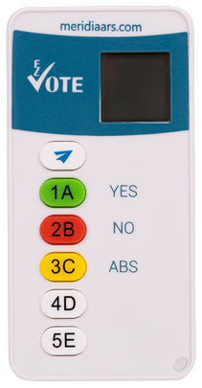
Town Meeting
Clicker Voting Instructions

Slide 3
INTRODUCTION
This meeting will be interactive - you will be asked to vote using a wireless remote clicker that you’ve been given
Please don’t take the remote with you – it doesn’t work outside of this room and has a high replacement cost
Return the remotes to the designated staff collecting them

Slide 4
ELECTRONIC VOTING
Each registered voter has received a (randomly assigned) voting device upon check-in
These devices use reliable radio frequency and are secure. NO INTERNET IS USED
If you leave your seat for any reason, return your voting clicker to a designated staff member, and it will be given back to you upon your return.
When the Town Meeting has concluded, all voting devices must be given to a staff member positioned at the exits. Please do not leave with the voting devices. They do not work outside of this room.

Slide 5
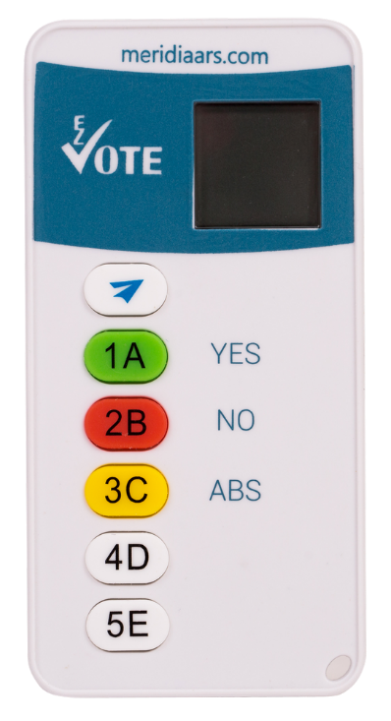
HOW TO VOTE
The Moderator will declare Open Vote and the Close of Vote
To respond, simply press the button on the keypad that matches your desired answer:
1A = YES
2B = NO
3C = ABSTAIN (if applicable)
Vote will be submitted/sent automatically and confirmed by showing “OK” on the display after each vote (or change of vote)
No need to press “Send” (paper plane)

Slide 6
WHEN IS the VOTE COUNTED?
Only respond when the vote is open
“OK” will appear on your keypad display, confirming receipt of the vote
If you’re not sure, vote again
You may correct your previous votes ONLY YOUR LAST VOTE COUNTS
Recorded results will appear on large overhead screen

Slide 7
Do not forget to turn in your voting devices!
THEY DO NOT WORK OUTSIDE OF THIS ROOM!

