Slide 1
Custom Membranes
Personalize Your Audience Response System

Slide 2
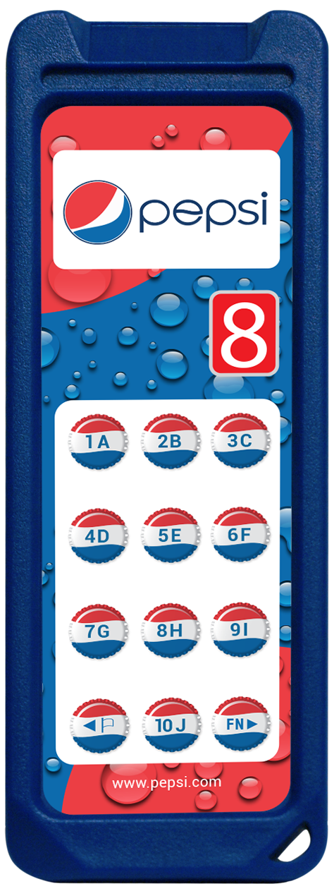
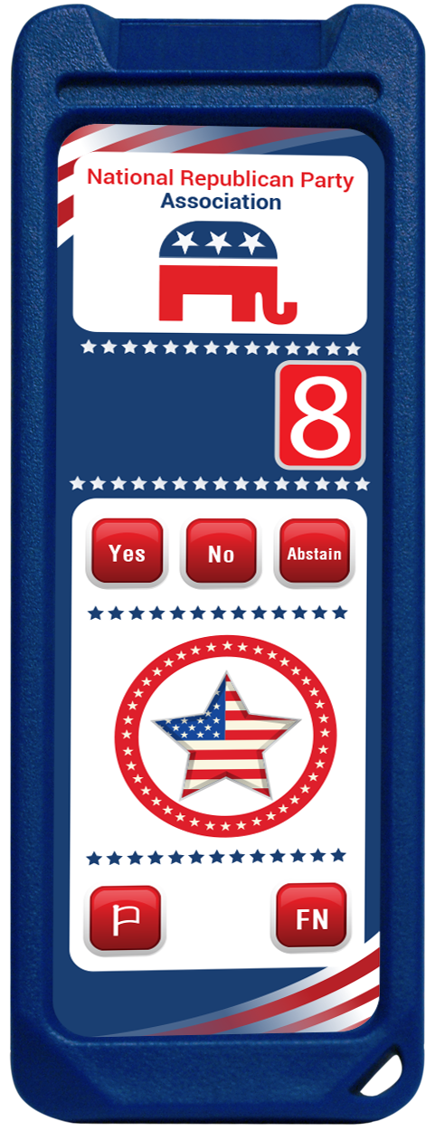
Corporate Branding
Add a corporate theme or logo on your clicker
Customize the button layout

Slide 3
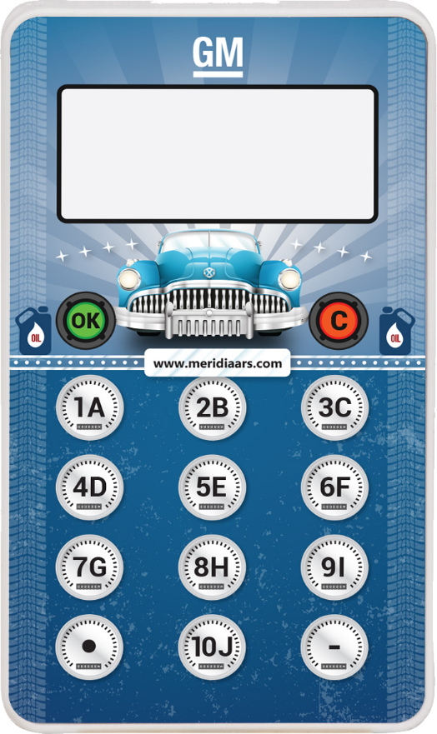
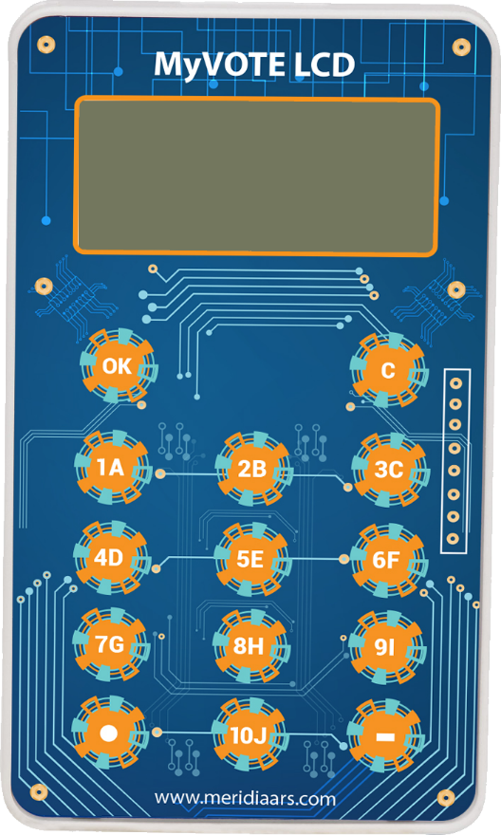
Personal Touch
Make your own design
Express who you are

Slide 4
Template for Every Clicker
Display and voting buttons are not physically movable
Create your own graphics and move it around the template
Don’t worry, this is just a mockup/sketch
Let us know how we can help

Slide 5
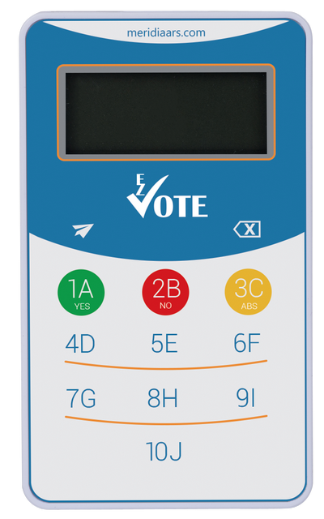
Template for Every Clicker
Your Logo
1A
2B
3C
4D
5E
6F
7G
8H
9I
OK
10J
C
your slogan

Slide 6
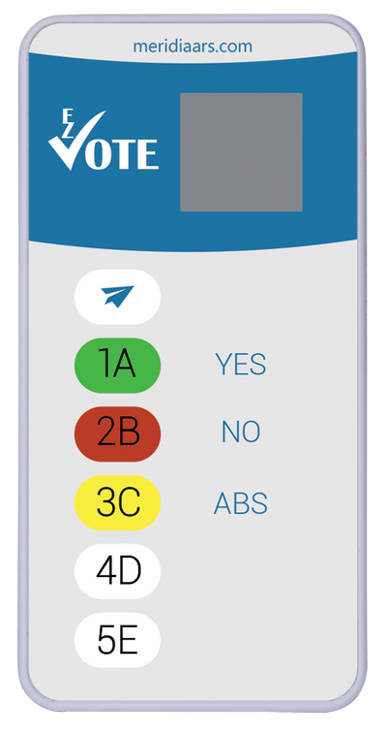
Template for Every Clicker
Your Logo
1A
2B
3C
4D
5E
OK
your slogan

Slide 7
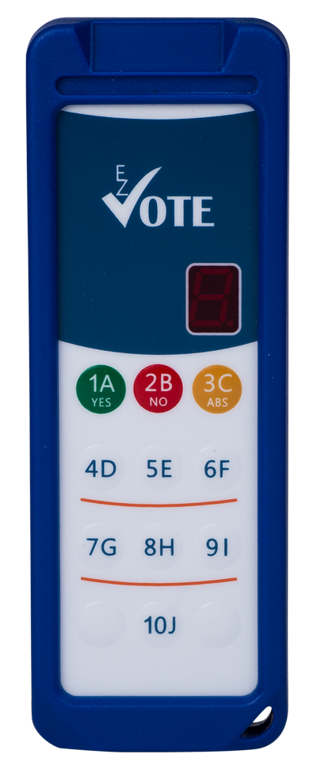
Template for Every Clicker
Your Logo
1A
2B
3C
4D
5E
6F
7G
8H
9I
OK
10J
C
your slogan

Slide 8
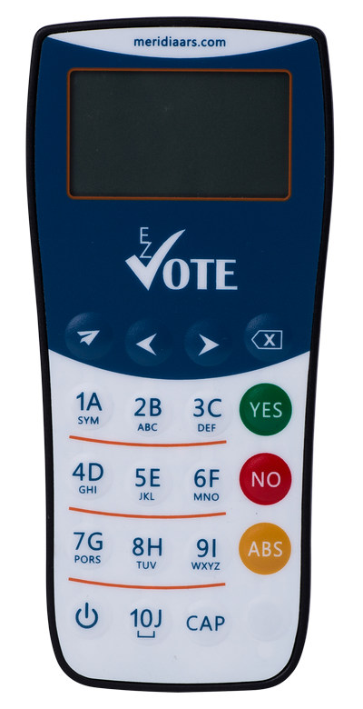
Template for Every Clicker
Your Logo
1A
2B
3C
4D
5E
6F
7G
8H
9I
OK
10J
C
your slogan

