Slide 1
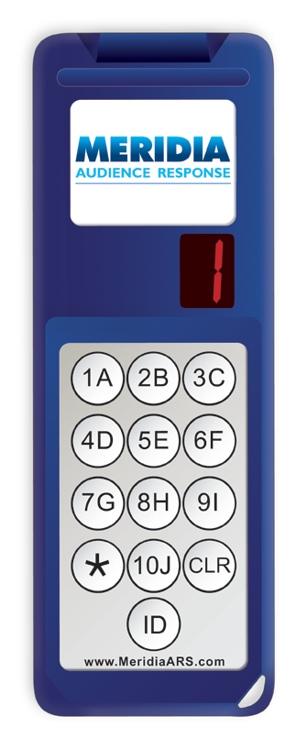
Using the Keypad
During this meeting, you will be asked to respond to interactive questions using the Meridia keypads.
To respond, simply press the button on the keypad that matches your desired answer.
Important: You may respond whenever the question is displayed, not just when the countdown clock appears.

